Slide 1
DAMG6210 - New York City (NYC) Citi Bike Sharing Final Project -Shrishti Diggikar

Slide 2
New York City (NYC) Citi Bike Sharing

Slide 3
NYC Citi Bike Share: Questions to answer
How many bike trips and what is the trend over time
calendar year (2017) Data Set 1 Query Data Set 2 Query
calendar month & year (2017-09) Data Set 1 Query Data Set 2 Query
calendar week (2017-36) Data Set 1 Query Data Set 2 Query
calendar day (2017-09-01) Data Set 1 Query Data Set 2 Query
Average number of bike trips and may also want to compare YOY (year over year) changes
per day, i.e., Sunday, Monday,…Saturday Data Set 1 Query Data Set 2 Query
weekday versus weekend Data Set 1 Query Data Set 2 Query
Month Data Set 1 Query Data set Query 2
calendar week Data Set 1 Query Data set 2 Query

Slide 4
NYC Citi Bike Share: Questions to answer
Examining when trips occur during the day
Breakdown of subscriber (or member) vs customer (non-subscriber) ridesData Set 1 Query Data Set 2 Query
How many bike trips occur during what periods of the day:
By hour (0900, 1300) Data Set 1 Query Data Set 2 Query
During periods during the day i.e., morning 6am-11:59am, afternoon noon-5:59pm, evening
6pm-10pm Data Set 1 Query Data Set 2 Query
How many round trips (start and end station are the same) versus non-round trips (different start and end station) Data Set 1 Query Data set 2 Query
Further breakdown subscriber vs customer
Average length of trip

Slide 5
NYC Citi Bike Share: Questions to answer
Examining length of trips
Length of trips (in time)
What is the average length (in minutes) of bike trip? Data Set 1 Query Data Set 2 Query
o Further breakdown by subscriber versus customer
How many trips are less than 15 minutes in duration? Data Set 1 Query Data Set 2 Query
How many trips are greater than 15 minutes but less than 1 hour in duration? Data Set 1 Query Data Set 2 Query
How many trips are greater than 1 hour in duration? Data Set 1 Query Data Set 2 Query

Slide 6
NYC Citi Bike Share: Questions to answer
Most popular stations
What are the top 10 bike stations based on bike trips?
For staring a trip
As a trip destination
Overall, as ether a start and/or destination Data set 1 query Data set 2 query
Determine the most popular routes (staring to end location)
Total number of trips
Total number of trips by subscriber and customer
Further breakdowns (examples): time of day, weekday vs weekend, month Data set 1 query Data set 2 query

Slide 7
NYC Citi Bike Share: Questions to answer
Gender analysis
How many trips - female vs male Data set 1 query Data set 2 query
Average length of trip - female vs male
Subscriber versus customer trips - female vs male
Any trends from 2014 to 2020 regarding above
Age analysis (note: age at the time of the ride i.e., age is year of bike trip vs birth year) Data set 1 query Data set 2 query
What are the number of trips per age
Average length of trip per age
Subscriber versus customer trips – per age
Any trends from 2014 to 2020 regarding above

Slide 8
NYC Citi Bike Share: Questions to answer
Bike Analysis
Data set 1 query
Data set 2 query
What are the top 5 bikes (bike id) for latest (full) year by
Total trips
Total time
Average trip time
For top bike (by total trips) create a history for the latest (full) year
Bike id
Route (state and end location)
Start time
Start location (id, longitude and latitude)
Duration

Slide 9
Moving data
Cloud to Cloud
Same Cloud Service (GCP, Azure, AWS, Snowflake, Oracle) and Same “region”
Same Cloud Service but different “region” – speed & ability to create view
Different Cloud Services & Different Cloud Applications i.e., Salesforce, Marketo
Files to/from Cloud Service, database, application
On-premise (your company network or your local database) to/from Cloud
Note:
Cloud databases, storage and applications are in physical data centers
An enterprise’s databases and applications
An enterprise’s physical data centers in their network
On one or more Cloud Services

Slide 10
Considerations
Data Types
datetime, timestamp
Big Query string, MySQL text
Database Functions such as datetime, timestamp, cast
Vary between databases
Trying to do it all at once

Slide 11
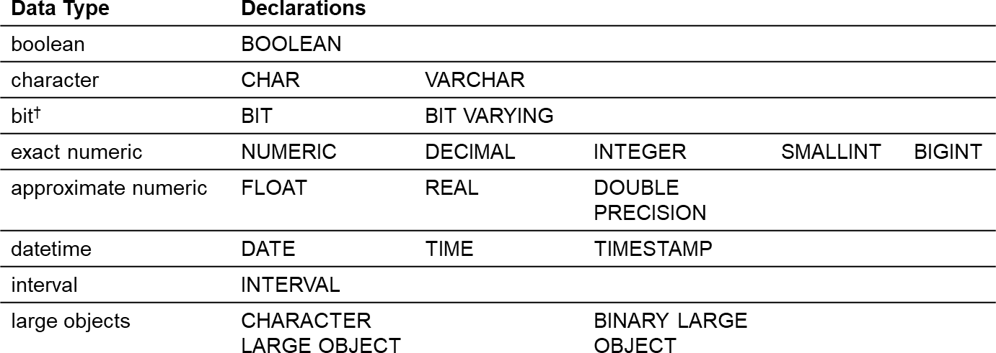
Considerations: Data Types
ISO SQL Data Types
MySQL Data Types
Oracle Data Types
Big Query Data Types

Slide 12
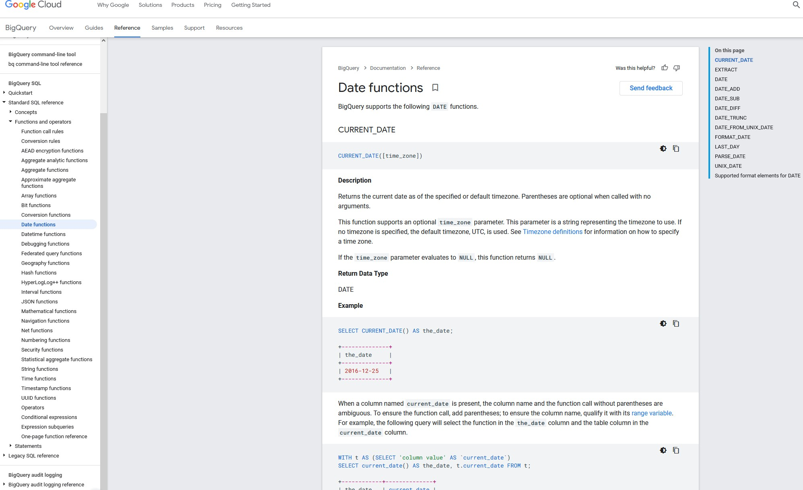
Considerations: Database Functions
https://cloud.google.com/bigquery/docs/reference/standard-sql/date_functions

Slide 13
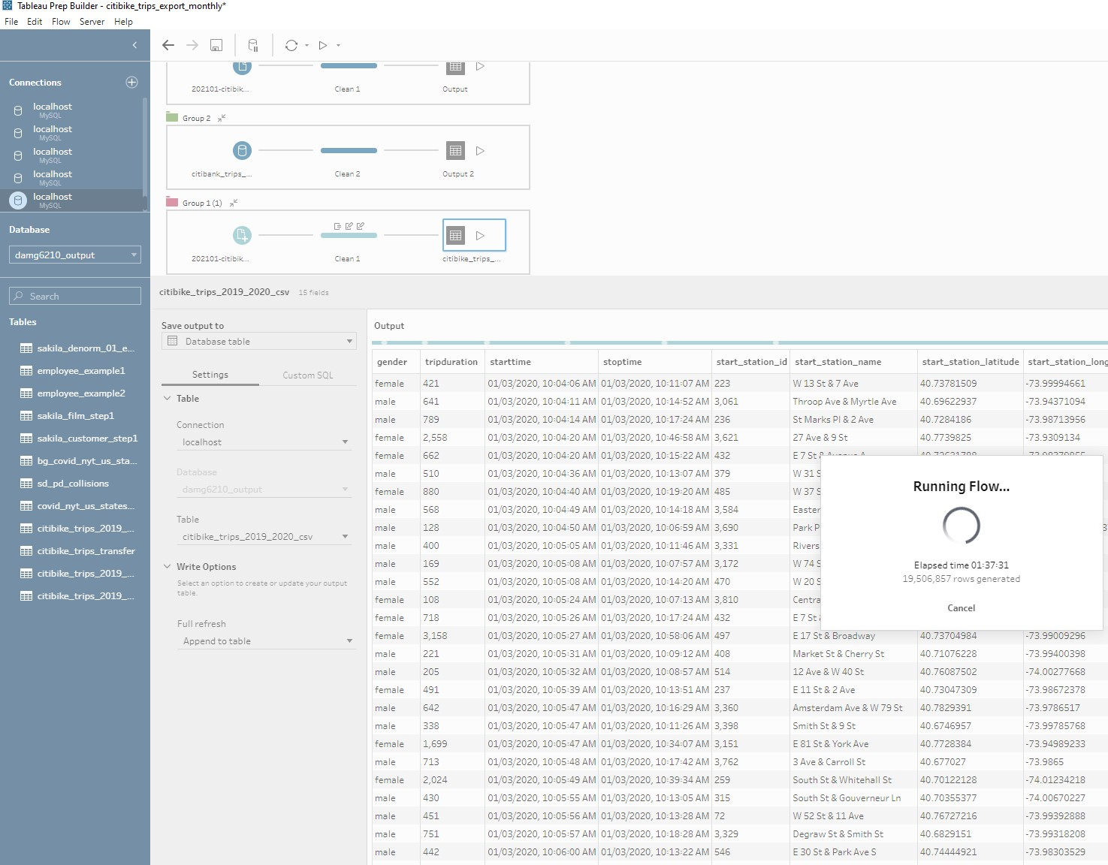
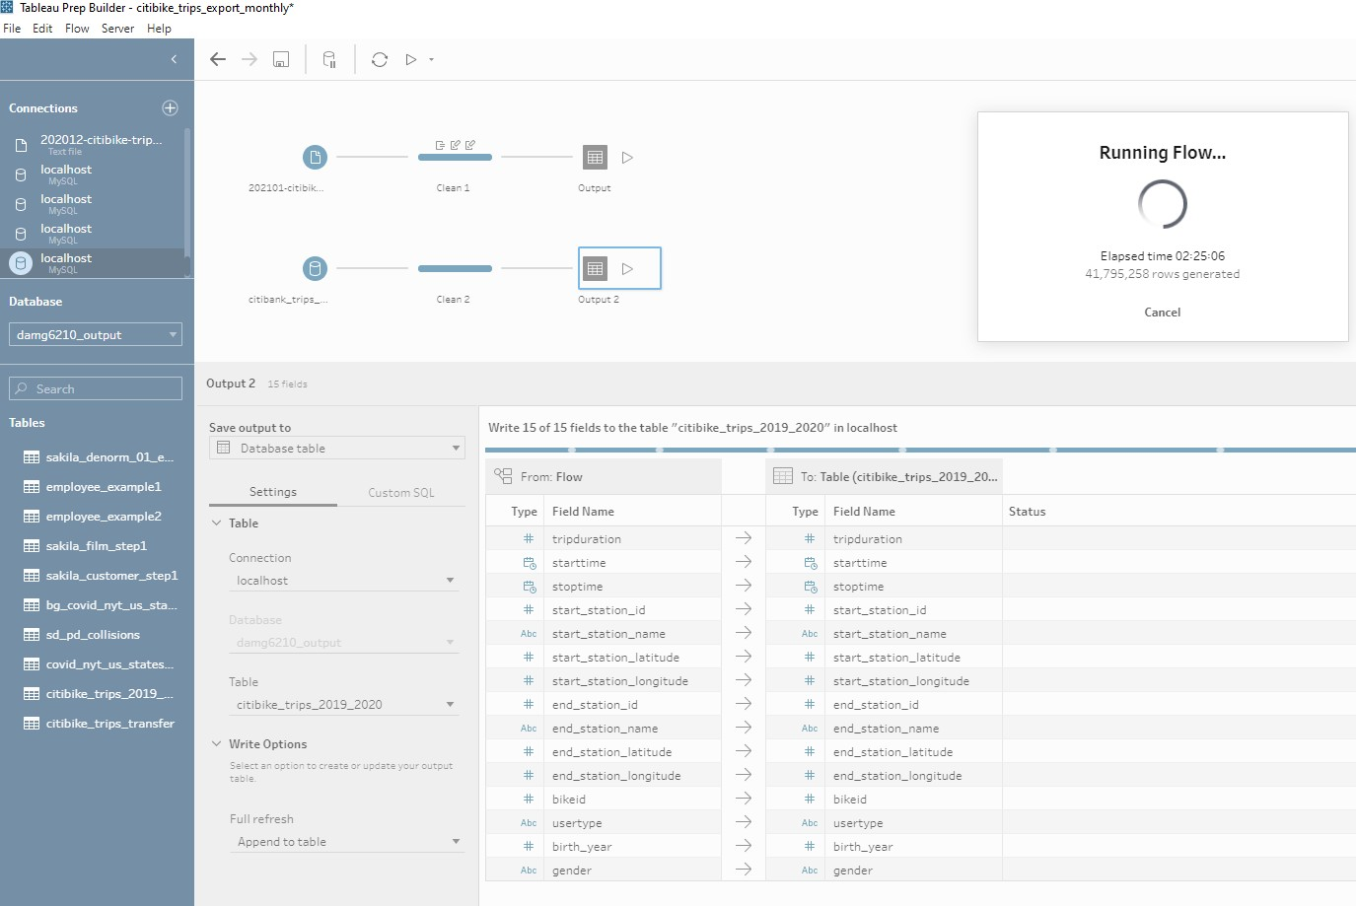
Considerations: Trying to do it all at once
Trying to load 2020 data from multiple files to MySQL
Trying to load 2019-2020 data from Big Query to MySQL

Slide 14
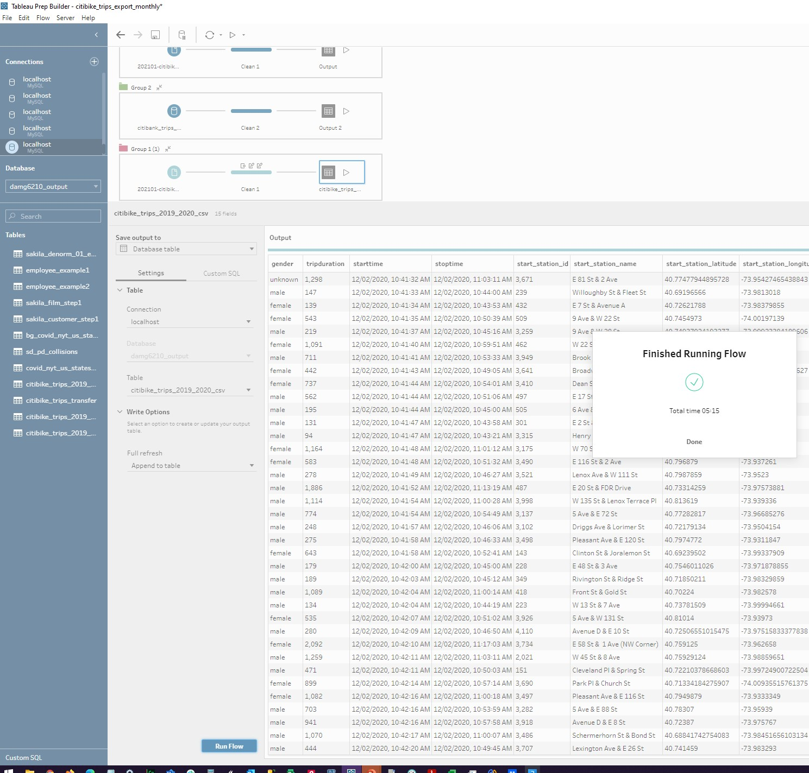
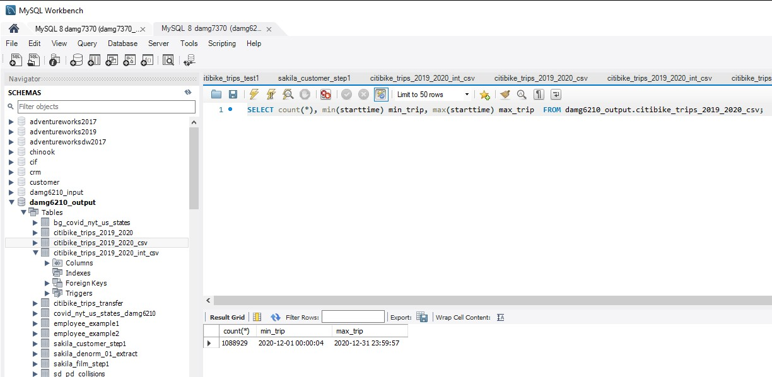
Considerations: Trying to do it all at once
Loading one file (month) at a time (202012) to MySQL

